Slide 1
CSC371-Database Systems I Lecture-7 (Lab) (Fall2023)

Slide 2
Previous Lecture Review
Data Insertion
Data Retrieval from single table

Slide 3
Create table
CREATE TABLE Branch (
branchNo varchar(10) NOT NULL PRIMARY KEY,
street varchar(50),
city varchar(50),
postcode varchar(20),
);

Slide 4
CREATE TABLE Staff(
staffNo VARCHAR(15) NOT NULL,
fName VARCHAR(15) NOT NULL,
lName VARCHAR(15) NOT NULL,
position VARCHAR(15) NOT NULL,
sex VARCHAR(15) NOT NULL,
DOB DATE NOT NULL,
salary INT NOT NULL,
branchNo VARCHAR(10) NULL,
CONSTRAINT pk_staffs PRIMARY KEY(staffNo),
CONSTRAINT fk_staffs FOREIGN KEY(branchNO) REFERENCES Branch1(branchNo)
);

Slide 5
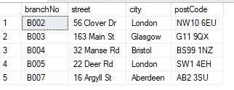
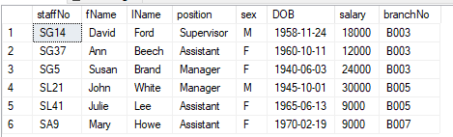
Branch
Staff

Slide 6
Agenda
Where Clause
Operators used in SQL
Logical Operators

Slide 7
Where Clause
Used to filter the records
Used with select statement
Used to update data of records
Used to delete records
Can also used to join more than one table

Slide 8
Operators used in SQL
Operator | Description
= | Equal
> | Greater than
< | Less than
>= | Greater than or equal
<= | Less than or equal
<> | Not equal. Note: In some versions of SQL this operator may be written as !=
BETWEEN | Between a certain range
LIKE | Search for a pattern
IN | To specify multiple possible values for a column

Slide 9

Where clause
SELECT column1, column2, ... FROM table_name WHERE condition;
Select * from branch where branchNo =‘B003’
Select * from staff where salary = 30000

Slide 10

Use of different operators within condition
Select * from staff where salary >= 18000

Slide 11
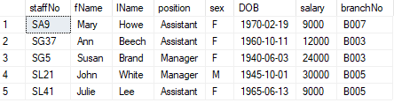
All values except…18000
Select * from staff where salary <> 18000

Slide 12


Use of between in where clause
Select * from staff where salary BETWEEN 12000 AND 18000
Select * from staff where salary NOT BETWEEN 12000 AND 18000

Slide 13


Use of IN Operator
Select * from staff where position IN ('MANAGER','SUPERVISOR')
Select * from staff where position NOT IN ('MANAGER','SUPERVISOR')

Slide 14


LIKE operator and wild card (%, _)
select * from branch where postcode LIKE 'sw1%'
select * from branch where postcode LIKE ‘AB2 3S_’

Slide 15
Logical Operators OR, AND, NOT

Slide 16
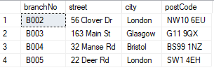
Logical Operator OR
SELECT column1, column2, ... FROM table_name WHERE condition1 OR condition2 OR condition3 ...;
We need the branch details for London, Bristol and Glasgow city.
Select * from branch where city = 'London' OR city ='Bristol' OR city = 'Glasgow'

Slide 17

Logical Operator AND
SELECT column1, column2, ... FROM table_name WHERE condition1 AND condition2 AND condition3 ...;
Select * From Branch WHERE city = 'London' AND branchNo= 'B002' AND postcode LIKE 'NW10%‘

Slide 18

Logical Operator NOT
SELECT column1, column2, ... FROM table_name WHERE NOT condition;
Select * From Branch WHERE NOT city = 'London‘
Select * From Branch WHERE NOT city = 'London' AND NOT city = 'Bristol'

Slide 19

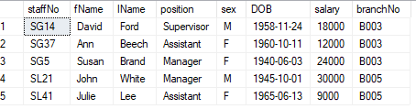
IS NULL , IS NOT NULL
SELECT column_names FROM table_name WHERE column_name IS NULL;
Select * From staff WHERE branchNo IS NULL
Select * From staff WHERE branchNo IS NOT NULL

Slide 20
Summary
Where Clause
Operators used in SQL
Logical Operators

